Slide 1
ICT-307
Design & Analysis of Algorithms
Greedy Algorithms

Slide 2
Greedy Algorithm
Greedy algorithms make the choice that looks best at the moment.
This locally optimal choice may lead to a globally optimal solution (i.e. an optimal solution to the entire problem).

Slide 3
When can we use Greedy algorithms?
We can use a greedy algorithm when the following are true:
The greedy choice property: A globally optimal solution can be arrived at by making a locally optimal (greedy) choice.
The optimal substructure property: The optimal solution contains within its optimal solutions to subproblems.

Slide 4
Designing Greedy Algorithms
Cast the optimization problem as one for which:
  we make a choice and are left with only one subproblem to solve
Prove the GREEDY CHOICE
  that there is always an optimal solution to the original problem that makes the greedy choice
Prove the OPTIMAL SUBSTRUCTURE:
  the greedy choice + an optimal solution to the resulting subproblem leads to an optimal solution

Slide 5

Greedy Algorithms
Part -1 : Greedy Coin Changing Algorithm

Slide 6
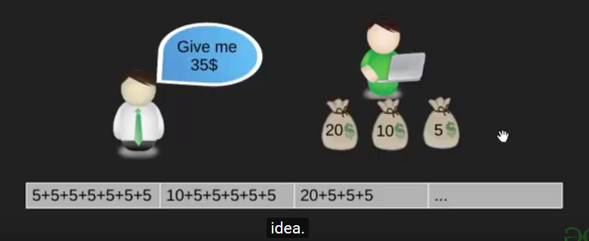
Coin Change

Slide 7
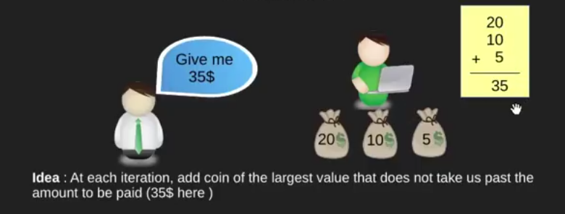
Objective
Pay out a given sum S with the smallest number of coins possible.

Slide 8
Coin Change
Assume that we have an unlimited number of coins of various denominations:
$1, $5, $10, $25, $50
Now use a greedy method to give the least amount of coins for $41
      41 – 25 = 16 ------ 25
      16 – 10 = 6 -------10
      6 – 5 = 1 ------- 5
      – 1 = 0 -------1
We have to give: 25 10 5 1

Slide 9
Making Change – A big problem - 1
Assume that we have an unlimited number of coins of various denominations:
$4 , $10, $25
Now use a greedy method to give the least amount of coins for $41
      41 – 25 = 16 ------ 25
      16 – 10 = 6 ------- 10
      6 – 4 = 2 ------- 4
      2 ------- ???
We should choose 25 4 4 4 4

Slide 10
Making Change – A big problem -2
Example 2: Coins are valued $30, $20, $5, $1
  Does not have greedy-choice property, since $40 is best made with two $.20’s,
  but the greedy solution will pick three coins (which ones?)

Slide 11
Algorithm
The greedy coin changing algorithm:
  while S > 0 do
  c := value of the largest coin no larger than S;
  num := S / c;
  pay out num coins of value c;
  S := S - num*c;

Slide 12
Greedy Algorithms
Part -2 : The Fractional Knapsack Problem

Slide 13

Knapsack Problem
0/1 Knapsack
  Either take all of an item or none.
Fractional Knapsack
  You can take fractional amount of an item.

Slide 14
Concept of Knapsack Problem
A Set of Items are given where,
  No of Items = n [X1, X2, X3, ….. Xn]
  Weight of Xi = Wi
  Profit of Xi = Pi
  Knapsack Size = m
Goal:
  Maximize the Profit ΣPiXi
  within ΣWiXi <= m

Slide 15
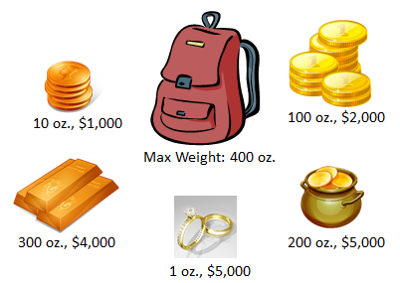

Fractional Knapsack

Slide 16
Fractional Knapsack problem
ITEM | PRICE | WEIGHT
X1 | 25 | 18
X2 | 24 | 15
X3 | 15 | 10
Three Cases:
  Maximum Price
  Minimum Weight
  Maximum Pi/Wi
X1 | X2 | X3 | Σ WiXi | Σ PiXi
1 | 2/15 | 0 | 20 | 28.2
0 | 1 | 1/2 | 20 | 31.5
0 | 10/15 | 1 | 20 | 31
Total Item , n = 10
Knapsack Size , m = 20

Slide 17
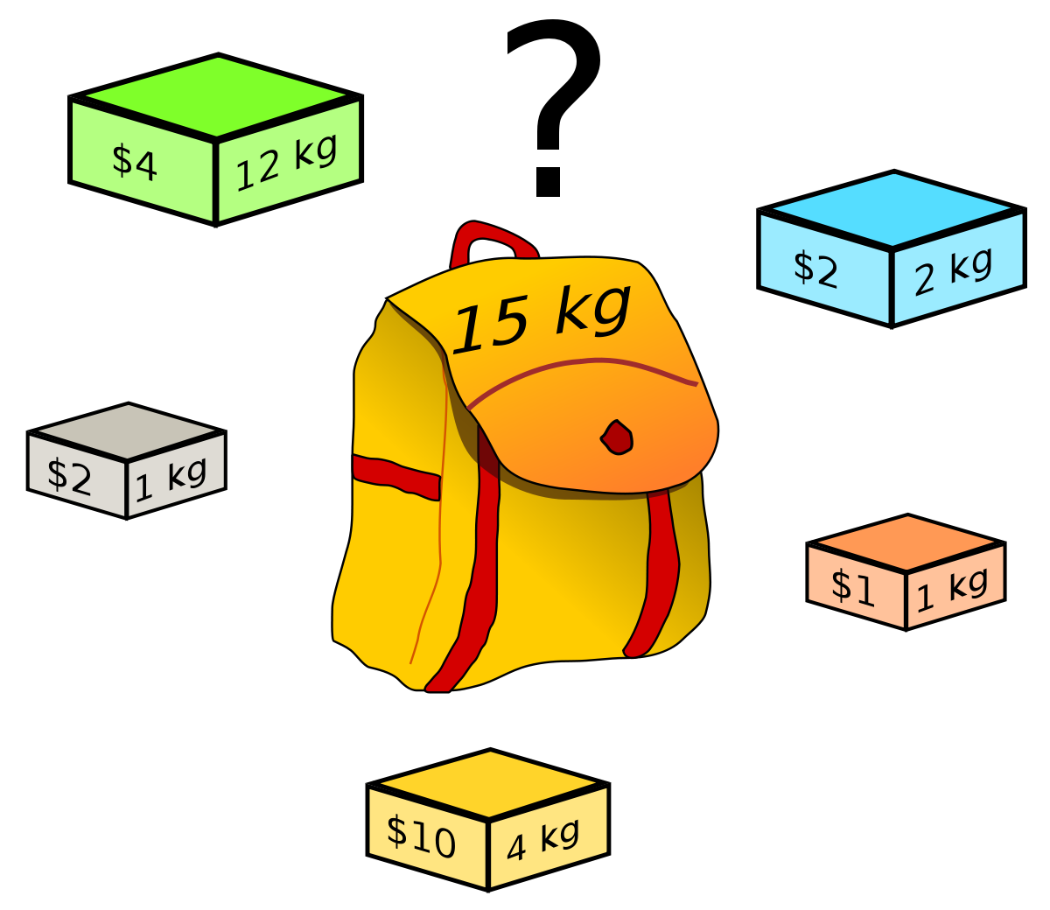
0/1 Knapsack

Slide 18

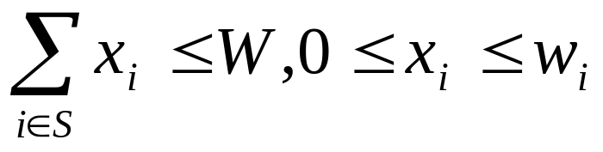
The Fractional Knapsack Problem
Given: A set S of n items, with each item i having
  b_{i} - a positive benefit
  w_{i} - a positive weight
Goal: Choose items with maximum total benefit but with weight at most W.
If we are allowed to take fractional amounts, then this is the fractional knapsack problem.
  In this case, we let x_{i} denote the amount we take of item i
  Objective: maximize
  Constraint:

Slide 19

Example
Given: A set S of n items, with each item i having
  b_{i} - a positive benefit
  w_{i} - a positive weight
Goal: Choose items with maximum total benefit but with total weight at most W.
“knapsack”
Solution: P
1 ml of 5 50$
2 ml of 3 40$
6 ml of 4 30$
1 ml of 2 4$
Total Profit:124$
Items:
1
2
3
4
5
Weight:
4 ml
8 ml
2 ml
6 ml
1 ml
Benefit:
$12
$32
$40
$30
$50
10 ml
Value:
3
4
20
5
50
($ per ml)

Slide 20

The Fractional Knapsack Algorithm
Greedy choice: Keep taking item with highest value (benefit to weight ratio)
  Since
Algorithm fractionalKnapsack(S, W)
Input: set S of items w/ benefit b_{i} and weight w_{i}; max. weight W
Output: amount x_{i} of each item i to maximize benefit w/ weight at most W
for each item i in S
  x_{i} ← 0
  v_{i} ← b_{i} / w_{i} {value}
  w ← 0 {total weight}
  while w < W
  remove item i with highest v_{i}
  x_{i} ← min{w_{i} , W - w}
  w ← w + min{w_{i} , W - w}

Slide 21
The Fractional Knapsack Algorithm
Running time: Given a collection S of n items, such that each item i has a benefit b_{i} and weight w_{i}, we can construct a maximum-benefit subset of S, allowing for fractional amounts, that has a total weight W in O(nlogn) time.
  Use heap-based priority queue to store S
  Removing the item with the highest value takes O(logn) time
  In the worst case, need to remove all items

Slide 22
Greedy Algorithms
Part -3 : Huffman Codes

Slide 23
Huffman Codes
Widely used technique for data compression
Assume the data to be a sequence of characters
Looking for an effective way of storing the data
Binary character code
  Uniquely represents a character by a binary string

Slide 24
Fixed-Length Codes
E.g.: Data file containing 100,000 characters
3 bits needed
a = 000, b = 001, c = 010, d = 011, e = 100, f = 101
Requires: 100,000 ⋅ 3 = 300,000 bits
 | a | b | c | d | e | f
Frequency (thousands) | 45 | 13 | 12 | 16 | 9 | 5

Slide 25
Huffman Codes
Idea:
  Use the frequencies of occurrence of characters to build a optimal way of representing each character
 | a | b | c | d | e | f
Frequency (thousands) | 45 | 13 | 12 | 16 | 9 | 5

Slide 26
Variable-Length Codes
E.g.: Data file containing 100,000 characters
Assign short codewords to frequent characters and long codewords to infrequent characters
a = 0, b = 101, c = 100, d = 111, e = 1101, f = 1100
(45 ⋅ 1 + 13 ⋅ 3 + 12 ⋅ 3 + 16 ⋅ 3 + 9 ⋅ 4 + 5 ⋅ 4)⋅ 1,000
= 224,000 bits
 | a | b | c | d | e | f
Frequency (thousands) | 45 | 13 | 12 | 16 | 9 | 5

Slide 27
Prefix Codes
Prefix codes:
  Codes for which no codeword is also a prefix of some other codeword
  Better name would be “prefix-free codes”
We can achieve optimal data compression using prefix codes
  We will restrict our attention to prefix codes

Slide 28
Encoding with Binary Character Codes
Encoding
  Concatenate the codewords representing each character in the file
E.g.:
  a = 0, b = 101, c = 100, d = 111, e = 1101, f = 1100
  abc = 0 ⋅ 101 ⋅ 100 = 0101100

Slide 29
Decoding with Binary Character Codes
Prefix codes simplify decoding
  No codeword is a prefix of another ⇒ the codeword that begins an encoded file is unambiguous
Approach
  Identify the initial codeword
  Translate it back to the original character
  Repeat the process on the remainder of the file
E.g.:
  a = 0, b = 101, c = 100, d = 111, e = 1101, f = 1100
  001011101 =
0
⋅ 0
⋅ 101
⋅ 1101
= aabe

Slide 30
Prefix Code Representation
Binary tree whose leaves are the given characters
Binary codeword
  the path from the root to the character, where 0 means “go to the left child” and 1 means “go to the right child”
Length of the codeword
  Length of the path from root to the character leaf (depth of node)
100
100
0
1
0
1
86
14
a: 45
55
0
1
0
0
1
25
30
58
28
14
0
1
0
1
0
1
0
1
0
1
c: 12
b: 13
14
d: 16
a: 45
b: 13
c: 12
d: 16
e: 9
f: 5
0
1
f: 5
e: 9

Slide 31
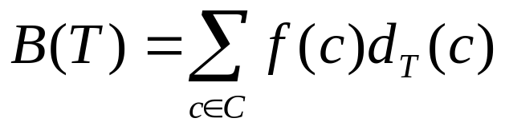
Optimal Codes
An optimal code is always represented by a full binary tree
  Every non-leaf has two children
  Fixed-length code is not optimal, variable-length is
How many bits are required to encode a file?
  Let C be the alphabet of characters
  Let f(c) be the frequency of character c
  Let d_{T}(c) be the depth of c’s leaf in the tree T corresponding to a prefix code
the cost of tree T

Slide 32
Constructing a Huffman Code
A greedy algorithm that constructs an optimal prefix code called a Huffman code
Assume that:
  C is a set of n characters
  Each character has a frequency f(c)
  The tree T is built in a bottom up manner
Idea:
  Start with a set of |C| leaves
  At each step, merge the two least frequent objects: the frequency of the new node = sum of two frequencies
  Use a min-priority queue Q, keyed on f to identify the two least frequent objects
f: 5
e: 9
c: 12
b: 13
d: 16
a: 45

Slide 33
Example
f: 5
e: 9
c: 12
b: 13
d: 16
a: 45
c: 12
b: 13
14
d: 16
a: 45
0
1
f: 5
e: 9
14
d: 16
25
a: 45
25
30
a: 45
0
1
0
1
0
1
0
1
f: 5
e: 9
c: 12
b: 13
c: 12
b: 13
14
d: 16
0
1
f: 5
e: 9
55
0
100
1
a: 45
0
1
a: 45
55
25
30
0
1
0
1
0
1
25
30
c: 12
b: 13
14
d: 16
0
1
0
1
0
1
c: 12
b: 13
14
d: 16
f: 5
e: 9
0
1
f: 5
e: 9

Slide 34
Building a Huffman Code
Alg.: HUFFMAN(C)
n ← ⎜C ⎜
Q ← C
for i ← 1 to n – 1
do allocate a new node z
left[z] ← x ← EXTRACT-MIN(Q)
right[z] ← y ← EXTRACT-MIN(Q)
f[z] ← f[x] + f[y]
INSERT (Q, z)
return EXTRACT-MIN(Q)
Running time: O(nlgn)
O(n)
O(nlgn)

Slide 35
Greedy Algorithms
Part -4 : Bin Packing Problem

Slide 36
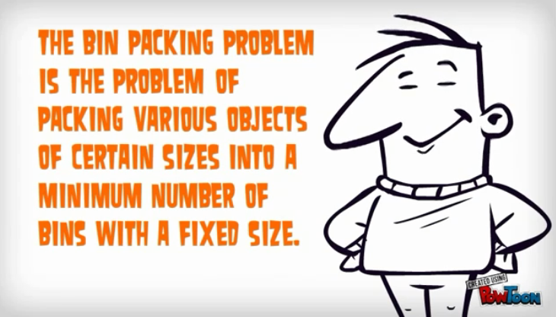
Concept

Slide 37
Bin Packing
In the bin packing problem, objects of different volumes must be packed into a finite number of bins or containers each of volume V in a way that minimizes the number of bins used.
There are many variations of this problem,
such as 2D packing,
linear packing,
packing by weight,
packing by cost, and so on.
They have many applications, such as filling up containers, loading trucks with weight capacity constraints, creating file backups in media and so on.

Slide 38
Ways of Solution
First Fit Algorithm
First Fit Decreasing Algorithm
Full Bin Algorithm
Other Algorithms

Slide 39
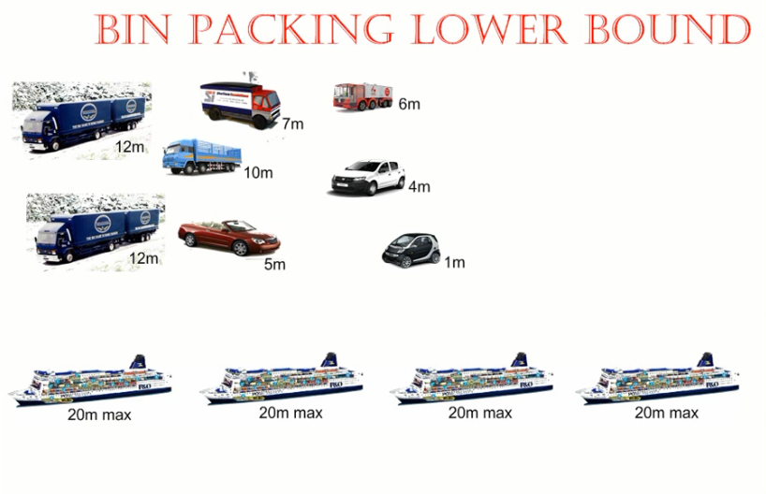
Find The Lower Bound
Total size = 12 + 12 + 7 + 6 + 10 + 4 + 5 + 1 = 57
Bin Size = 20
Lower Bound = 57/20
= 2.85 = 3

Slide 40
First Fit Algorithm
This is a very straightforward greedy approximation algorithm.
The algorithm processes the items in arbitrary order.
For each item, it attempts to place the item in the first bin that can accommodate the item. If no bin is found, it opens a new bin and puts the item within the new bin.

Slide 41
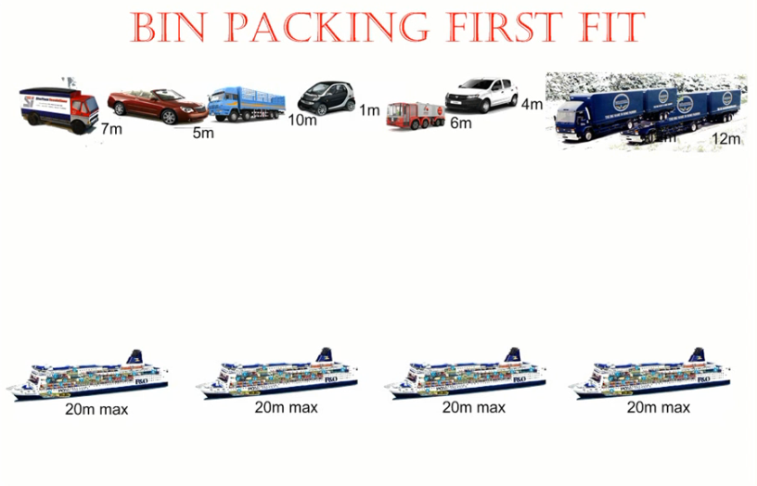
First Fit

Slide 42
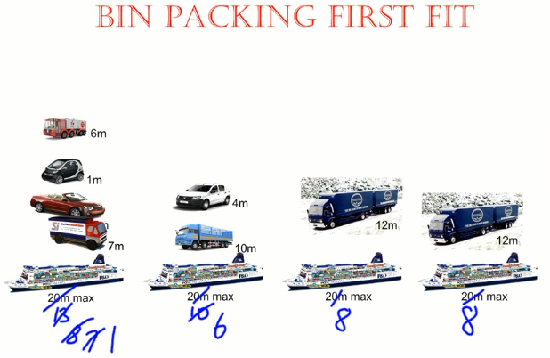
First Fit Solution

Slide 43
First Fit Decreasing Algorithm
Sort the items in decreasing order.
Repeat the process First Fit.

Slide 44
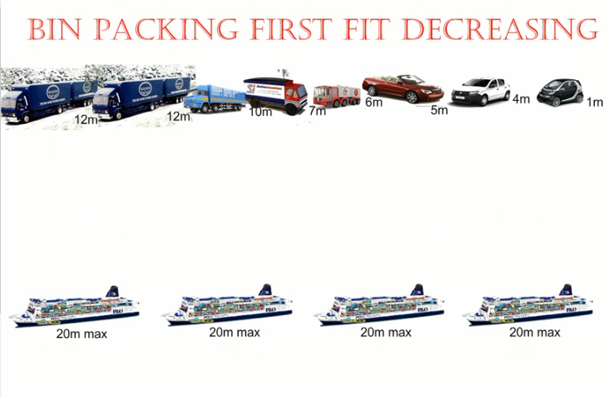
First Fit Decreasing

Slide 45
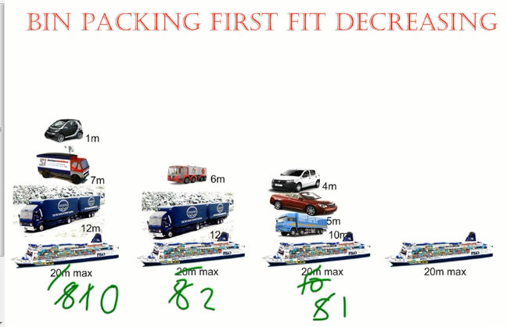
First Fit Decreasing Solution

Slide 46
Full Bin Algorithm
The full bin packing algorithm is more likely to produce an optimal solution – using the least possible number of bins – than the first fit decreasing and first fit algorithms. It works by matching object so as to fill as many bins as possible.

Slide 47
Full Bin Concept
Place the Items into the most full bin, which could accept it.
Keeps bins open even when the next item in the list will not fit in the previous opened bins, in the hope that a later smaller item will fill.
Put it in the bins so that smallest empty space is left.

Slide 48
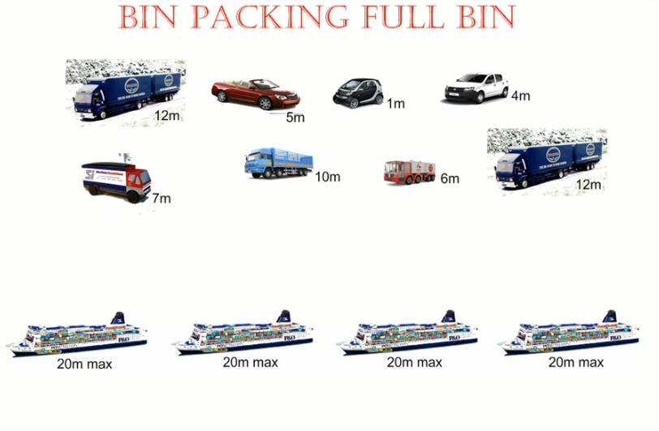
Full Bin Example

Slide 49
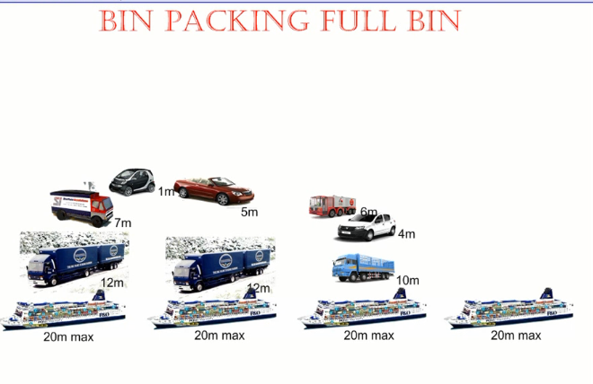
Full Bin Solution

Slide 50
Analysis
FIRST FIT
  Easiest to use
  Isn’t optimal
FIRST FIT DCREASING
  Easy to use
  Isn’t optimal always
FULL BIN
  Optimal
  Difficult to use

Slide 51
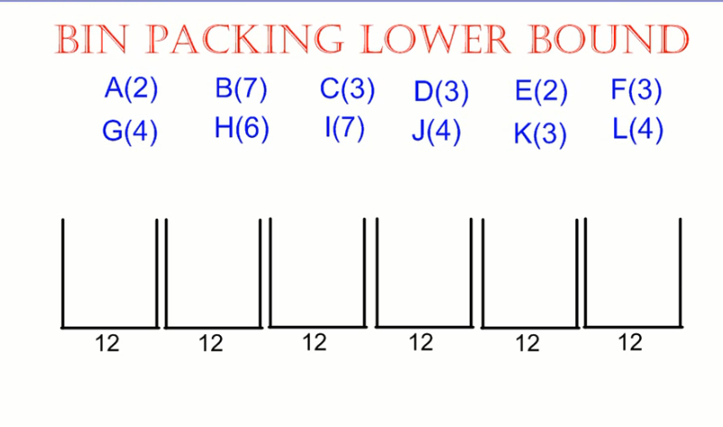
Try By yourself

Slide 52
Drawbacks of Greedy Methods
Does not always find the optimal solution for some problems.

